Slide 1
Capability Profile
2018

Slide 2
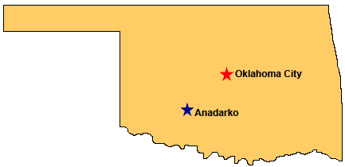
Tribal Purpose
The Wichita and Affiliated Tribes’ Wichita Tribe Industrial Development Commission (WTIDC) has oversight for Anadarko Industries, LLC (AI).
AI was established as an economic development project to generate profits that can be used to benefit all members of the Tribe.
Incorporated by Tribe in July 2003
AI is a Small Disadvantaged Business (SDB)
President of the Wichita and Affiliated Tribes is Ms. Terri Parton
Tribal Government
Headquarters located in Anadarko, Oklahoma
2,857 tribal members receive benefits from AI
AI has distributed over $10 M to WTIDC
2
Notes:
2

Slide 3
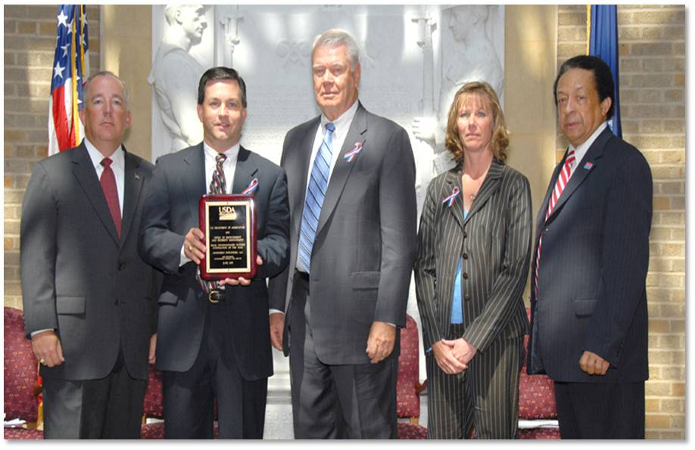
Philosophy and Results
Mission
Our Mission is to provide the highest quality services and products to our customers to create added value.
Values
We value our employees, our customers, our partners and our reputation.
Culture
Anadarko Industries is part of the Wichita Tribe family. We embrace the cyclical “spirit” of the Tribe as we encounter challenges each day. Our approach to Quality is driven by a continuous cycle of improvements and innovations from our employees who are devoted to serving our customers in the best way possible.
Strategy
Our strategy for success is to excel as a value-added partner to government agencies, large prime contractors and small businesses providing government support services.
Awards & Recognitions
USDA Small Disadvantaged Business (SDB) of the Year
OSHA VPP STAR Certified
NASA Space Flight Awareness Award
NASA JSC Super NOVA Safety Awards
NASA JSC Mentor of the Year
Houston Business Journal Recognized:
Top 10 Largest NASA Johnson Space Center contractor
Top 20 Largest Houston Technology Employers
Top 11 Largest Houston Area Minority-Owned Business
Anadarko Industries was selected as the Eighteenth (11th) Largest Minority-Owned Business in the Houston Area
Anadarko Industries was selected as the Small Disadvantaged Business of the Year by the USDA

Slide 4
Company Data
Native American Tribal Owned Small Disadvantage Business (SDB)
CAGE Code: 3K4Q0
DUNS #: 136727786
Size FAR Clause 19.703 - Subcontracts awarded to an Indian tribe shall be counted towards the subcontracting goals for small business and small disadvantaged business concerns, regardless of the size or Small Business Administration certification status of the Indian tribe.
Texas HUB Vendor
NAICS Codes:
493110* General Warehousing and Storage
518210* Data Processing, Hosting, and Related Services
519190 All Other Information Services
541511* Custom Computer Programming Services
541512* Computer Systems Design Services
541513* Computer Facilities Management Services
541519* Other Computer Related Programming Services
541330(a)* Engineering Services
541611 Administrative Management and General Management Consulting Services
541712* Research and Development in the Physical, Engineering, and Life Sciences (except Biotechnology)
541690 Other Scientific and Technical Consulting Services
541930 Translation and Interpretation Services
541990 All other Professional, Scientific, and Technical Services
561210* Base Facilities Operation Support Services
*AI qualifies as a small business prime contractor.
Note: As tribal-owned, always small as a subcontractor for all NAICS.
System for Award Management (SAM) Data
1-year Rolling Average Headcount is 79 employees
3-year Average Revenue is $17.8 M
DCAA Audited and Approved Accounting System
Strong Financial Condition
Debt Free, Strong Financial Position with Substantial Line of Credit and Significant Working Capital
Positive Past Performance Evaluations on All Contracts
Strong Management Team with Emphasis on Quality Performance
Stable Infrastructure with Excellent Employee Benefits
97.8% Incumbent Employee Capture Rate Since Company Inception in 2003
100% New Hire Capture Rate for 2015 - 2017
Competitive Indirect Rate Structure
AI Website:
www.anadarko-industries.com

Slide 5
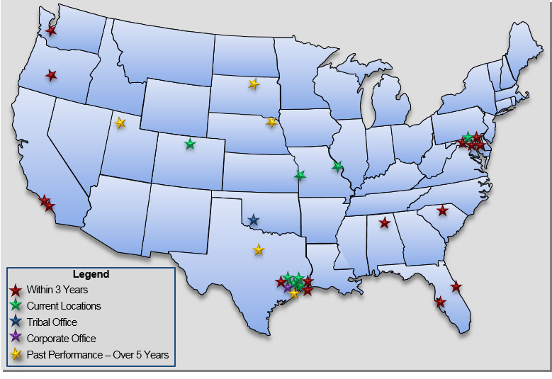
Locations and Customers
Dispersed National Geographic Operating Locations
Federal Agencies:
Air Force Office of Scientific Research (AFOSR)
Department of Defense (DoD)
NASA
Johnson Space Center (JSC)
Marshall Space Flight Center (MSFC)
Kennedy Space Center (KSC)
Office of Naval Research (ONR)
USDA Forest Service
USDA OCIO
Washington, DC
St. Louis, MO
Kansas City, MO
Fort Collins, CO
Prime Contractors:
(The) Boeing Company
CACI, Inc.
JMark Services
KBRwyle
Logical Innovations
ManTech
MEI Technologies, Inc.
NLT Management Services.
PAE Applied Technologies
STS Systems Integrations
SureSecure Solutions
TechTrans International
UTC Aerospace Systems

Slide 6
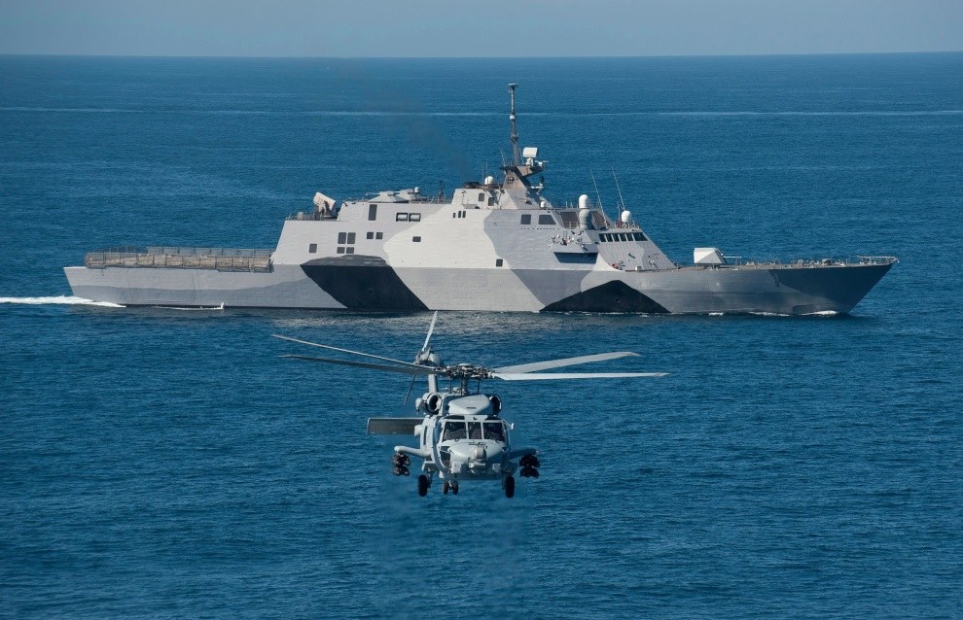
Contracting Avenues
Contracting Avenues in Place
SeaPort-e Prime
Enterprise IT Policy & Planning, Custom Application Development & Product Integration (ENCORE II)
NASA Agency Consolidated End-User Services (ACES)
General Dynamics Design Engineering Support Program (GDIT DESP III)
U.S. Army Intelligence & Security Command Global Intelligence (INSCOM GI)
SOCOM Wide Mission Support (SWMS Group A)
Network Centric Solutions 2 (The NETCENTS 2) Application Server

Slide 7
Core Capabilities
Information Technology
Business & Contract Operations
Help Desk/End User Support (Tiers 1, 2, 3)
Systems Management (Networks, Cloud, Servers)
Software Development and Maintenance
Field Studies / Benchmarking
Asset Management
Program Management
Contract Management
Financial Analysis
Procurement and Acquisition Services
Property and Asset Management
Human Resources Management
Administrative and Clerical Support
Logistics & Facility Operations
Warehousing Operations
Shipping and Receiving; including Flight Equipment
Inventory Management
Material Management; including Hazmat Items
Staging and Site Delivery
VIP Tours and Chauffer Services
Police Escorts
MILDEC Operations
IT Asset Management in Remedy
Workorder Management in MAXIMO
Facility Engineering Management
Engineering & Technical Services
Institutional Safety
Fire Protection Engineering & Technical Support
OSHA VPP/Occupational Health
Safety Metrics and Analytics
Health and Human Performance
Biomedical and Scientific Research
Human Factor Analysis
Systems Engineering and Integration
Aerospace, Mechanical, Electrical, GN&C, ECLSS
Payloads Integration / Mission Operations
Facility Engineering
Test Safety Operations

Slide 8
Information Technology
What We Do
End User Support
Help Desk/End User Support (Tiers 1, 2, 3)
End User Training
Call Center Operations
Remote Support
New Deployments and Upgrades
Systems Management
System analysis and design
Network administration
IT systems configuration control
Server Maintenance
Cloud virtual servers
Software Development
Business Process design and development
Application Development (i.e. AGILE)
Database design and management
Software verification and validation
Web and Portal Design (i.e. SharePoint)
Field Studies/Benchmarking
Asset Management
Customers
National Aeronautics and Space Administration (NASA) Johnson Space Center (JSC)
United States Department of Agriculture (USDA)
USDA Forest Service
Wichita Tribal Enterprises, LLC
8
Notes:
8

Slide 9
Information Technology (cont.)
Contracts
Current
USDA Large Office End User Support Services
NASA JSC Center Safety & Fire Operations (CSFO)
NASA JSC Human Health & Performance Contract (HHPC)
3-Year Past Performance
Forest Service Automated Timber Sales Accounting (ATSA)
USDA Large Office End User Support Services
5-Year Past Performance
NASA JSC Center Institutional Safety Services (CISS)
Forest Service Acquisition Management Systems (AQM)
Additional Past Performance
Forest Service Virtual Incident Procurement (VIPR) System
NASA JSC Human Resources and Procurement Office (HRPO)
Forest Service Financial Systems Support
Achievements
Awarded Small Disadvantaged Business of the Year
AI consolidated six USDA large office infrastructure support contracts into one standardized contract gaining synergies and reducing operating costs
Two Exceptional Software awards for Workforce Transformation Tracking System at NASA
"Initial VIPR system rolled out on schedule to meet Forest Service upcoming fire season. http://www.fs.fed.us/business/incident/vipr.php"
Developed and integrated HR portal for NASA JSC that was adapted at headquarter level.
Increased customer satisfaction from 50% to 98% approval at USDA Washington, D.C. Office.
Developed JSC integrated Safety Reporting and Tracking System (SRTS).
Exceptional USDA CPAR Review:
Anadarko has consistently worked to increase the qualify of work as well as maintain the support levels at those high quality levels. Anadarko worked diligently throughout the performance period to adapt to the ever changing work climate in the USDA Washington, D.C. Office. They have increased and now maintain a high customer feedback rating. Quality of service has trended up during the performance period due to Anadarko’s process improvement collaboration with Government staff. - USDA Contracting Officer
9
Notes:
9

Slide 10
Logistics & Facility Operations
What We Do
Facility Logistics
Warehousing Operations
Shipping and Receiving; including Flight Equipment
Inventory Management
Material Management; including Hazmat Items
Staging and Site Delivery
Transportation and Fleet Management
VIP Tours and Chauffer Services
Police Escorts
IT Asset Management in Remedy
Work order Management in MAXIMO
Facility Engineering Management
Strategic Military Information Operations Planning and Operations
Consultant services to support Psychological Operations, Electronic Warfare, Operations Security, Military Deception and Computer Network Operations on site at the U.S. Combatant Commands worldwide
Support to Department of Defense (DoD) training efforts in field of military strategic and operational planning
Expert analytical and historical research in field of military planning and military information warfare and operations, to include the publication of unclassified and classified white papers and studies for the senior leadership of the DoD.
Customers
National Aeronautics and Space Administration (NASA) Johnson Space Center (JSC)
Department of Defense (DoD)
Office of Naval Research (ONR)
Pacific Architects and Engineering (PAE)
Computer Sciences Corporation (CSC)
DynCorp International
ManTech, Inc.
CACI, Inc.
JMark Services
10
Notes:
10

Slide 11
Logistics & Facility Operations (cont.)
Contracts
Current
NASA JSC Facility Support Services (FSS)
Russian Language & Logistics Services
3 Year Past Performance
Support Services for the Office of Naval Research (ONR) for the Corporate Logistics Department (BD04)
US Special Operations Command (USSOCOM)/Global Battlestaff and Program Support (GBPS) Information Operations and Irregular Warfare Analyst Support
Military Deception (MILDEC)/Operations Security (OPSEC) Support
Policy Analysis, Security and Operations (PASO) Support
Additional Past Performance
Bella Contractor Support
Under Secretary of Defense (Intelligence) Tampa MILDEC Planner Support Services
NASA JSC Center Operations Support Services (COSS)
Achievements
Received award for Hurricane Ike recovery efforts
Responsible for loading and transporting $3 Million Moon Rover
Lightning Bolt Award
Responsible for supplying and maintaining 2 vending machines with commonly used tools and personal protective equipment (PPE) for 24/7 access
Implemented and Operate a Consignment Room for readily available supplies
Exceptional USDA CPAR Review:
Anadarko has consistently worked to increase the qualify of work as well as maintain the support levels at those high quality levels. Anadarko worked diligently throughout the performance period to adapt to the ever changing work climate in the USDA Washington, D.C. Office. They have increased and now maintain a high customer feedback rating. Quality of service has trended up during the performance period due to Anadarko’s process improvement collaboration with Government staff. - USDA Contracting Officer
11
Notes:
11

Slide 12
Engineering &
Technical Services
What We Do
Institutional Safety
Facility Construction and Maintenance Safety
Fire Protection Engineering
Maintenance and inspection of fire protection systems
Test safety operations
Safety information systems
Safety data reporting and trend analysis
Safety awareness campaigns
OSHA and Safety Training
First Response Activities
Evacuation Planning and Drills
Occupational Health
Systems Engineering and Integration
Aerospace Engineering (i.e. International Space Station)
Payloads Integration
Human Factors Analysis (IVA/EVA)
Structural/Mechanical/Electrical/Propulsion
Guidance, Navigation & Control (GN&C)
Command & Data Handling (C&DH)
Thermal Control Analysis
Communication Systems
Environmental Control and Life Support Systems (ECLSS)
Stress Analysis
Real Time Mission Operations Support
Test and Verification
Facility Engineering
Facility Buildouts and Modifications
Facility Maintenance and Operations
Moves and Upgrades
Health and Human Performance
Health, Research and Laboratory Services
Biomedical and Scientific Research
Flight and Ground Occupational Health Programs
Human Factors Analysis

Slide 13
Engineering &
Technical Services (cont.)
Customers
National Aeronautics and Space Administration (NASA) Johnson Space Center (JSC)
Office of Naval Research (ONR)
The Boeing Company
KBRwyle
MEI Technologies
NLT Management Services, LLC
DynCorp International
Contracts
Current
NASA JSC Center Safety & Fire Operations (CSFO)
NASA JSC Human Health & Performance Contract (HHPC)
3 Year Past Performance
Boeing Engineering Technical Services (BETS)
Support Services for the Office of Naval Research (ONR) for the Corporate Logistics Department (BD04)
Additional Past Performance
NASA JSC Center Institutional Safety Services (CISS)
NASA JSC Safety and Fire Services (SFS)
Air Force Office of Scientific Research (AFOSR)
NASA JSC Center Operations Support Services (COSS)
NASA JSC Calibration and Metrology Services (CAMS)
Achievements
OSHA VPP STAR Certified Contract
Awards for Hurricane Ike Recovery Efforts
Boeing Silver Supplier Award 5 consecutive years
NASA JSC Safety Action Team (JSAT) Awards
NASA JSC “Going the Extra Mile” (GEM) Awards
NASA JSC Supernova Safety Awards
Silver Snoopy Award
Licenses / Certifications
Texas Fire Marshal's Office (Alarm, Sprinkler, Extinguisher)
Certified Safety Professionals
Fire Protection Professional Engineer, PE
OSHA VPP STAR
Exceptional CISS CPAR Review:
“The contractor continues to be responsive to NASA’s dynamic safety environment in spite of having reductions in its workforce. Further, the contractor fosters an environment of teamwork that allows it to effectively partner with NASA to ensure mission success...The contractor works very closely with Civil Service Management. The contractor is a valued member of the team, providing advice.” - CISS Contracting Officer

Slide 14
Business & Contract Operations
What We Do
Business Management
Program Management
Contract Management
Financial Analysis
Procurement and Acquisition Services
Property and Asset Management
Human Resources Management
Administrative and Clerical Support
Configuration Management
Meeting Support (i.e. scheduling, agenda, minutes)
Documentation Preparation
Records and Data Management
Review Cycle Coordination
Outreach and Event Support
Conference and Event Planning (Turn Key)
Website Registrations
Brochures, Agendas, Programs, Presentations
International Programs
Safety Awareness Events
Operational Support
Automobile leasing
Technical communication support
Librarian and historian
Key Customers
Air Force Office of Scientific Research (AFOSR)
National Aeronautics and Space Administration (NASA) Johnson Space Center (JSC)
Office Of Naval Research (ONR)
United States Department of Agriculture (USDA)
UTC Aerospace Systems
Pacific Architects and Engineering (PAE)
Computer Sciences Corporation (CSC)
DynCorp International
KBRwyle
NLT Management Services
14
Notes:
14

Slide 15
Business & Contract Operations (cont.)
Contracts
Current
NASA JSC Facilities Support Services (FSS)
USDA Large Office End User Support
3-Year Past Performance
NASA JSC Extravehicular Activity (EVA) Space Operations Contract (ESOC)
NASA JSC Procurement Services Contract (PSC)
Support Services for the Office of Naval Research (ONR) for the Corporate Logistics Department (BD04)
USDA Large Office End User Support
Additional Past Performance
Air Force Office of Scientific Research (AFOSR) Support Services
NASA JSC Human Resources & Procurement Offices (HRPO) Support Services
NASA JSC Center Operations Support Services (COSS)
Achievements
Saved AFOSR $3M resulting in Outstanding Contracting Team Award for Air Force Research Laboratory (AFRL)
Exceptional CPAR Ratings
Consolidation of 6 contracts and contractors into one AFOSR contract
Renewable Energy/Wind Turbine Installation at JSC Childcare Facility
Handled $20M in Recovery Act Funding for JSC Projects
Received Group Achievement awards for bringing JSC power supply feeds back up over a week prior to Space Shuttle Launch
Exceptional AFOSR CPAR Review:
“This past 12 months of performance by Anadarko Industries in conjunction with their subcontractor has been one of the most positive contract experiences I have ever encountered. Always on time with deliverables, responsive to varying demands, reactive to emergent situations, proactive to preclude issues on future AFOSR needs, effectively cross-utilizing personnel to accomplish the mission, and creative in development of ideas to save government costs. While there is always room for improvement in any effort, it is difficult to imagine where that would apply on this contract.” - AFOSR Contracting Officer
15
Notes:
15

Slide 16
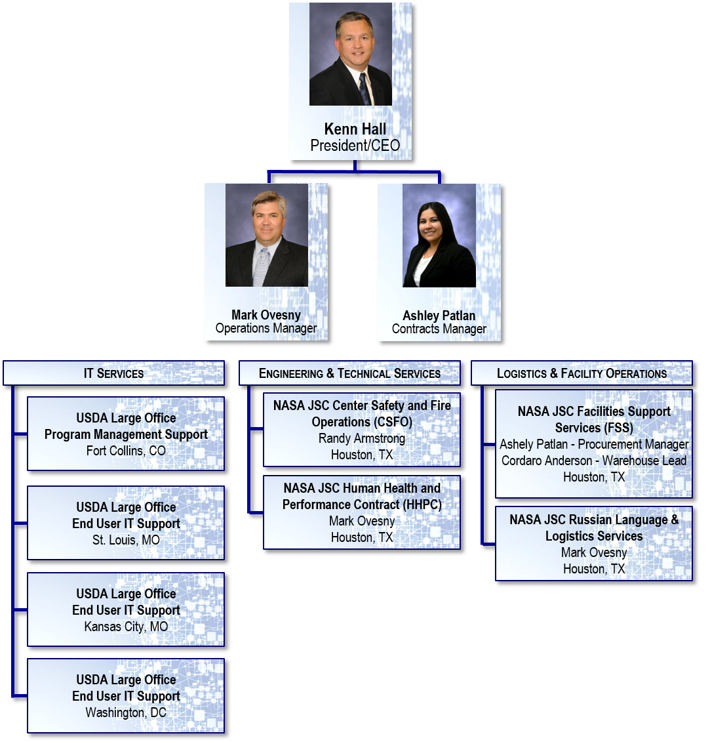
Corporate Office

Slide 17
Benefits of Using AI
Benefits of Using AI
Per FAR Clause 19.703: Subcontracts awarded to an ANC or Indian tribe shall be counted towards the subcontracting goals for small business and small disadvantaged business (SDB) concerns, regardless of the size or Small Business Administration certification status of the ANC or Indian tribe.
Therefore, prime contractor can subcontract to AI and receive small business and small disadvantaged business (SDB) credit for life of contract without consideration of prime contract’s NAICS code or size standard.
Also, when one or more subcontractors are in the subcontract tier between the prime contractor and AI, the prime contractor can still count our subcontract revenue towards achieving the contract’s small business and SDB subcontracting goals.
AI is a dynamic enterprise excelling in both Government prime contractor and subcontractor roles
Experienced core management team
Competitive and realistic indirect rates
Comprehensive compensation package
Access to many capable resources
DCAA Audited and Approved Accounting System
AI is a high quality cost competitive small disadvantaged business

Slide 18
Please Contact Us
Kenn Hall
President/CEO
Office: (281) 286-9202
Cell: (832) 723-8260
khall@anadarko-industries.com
Corporate Office
1322 Space Park Drive, Suite A256
Houston, Texas 77058
www.anadarko-industries.com

