Slide 1
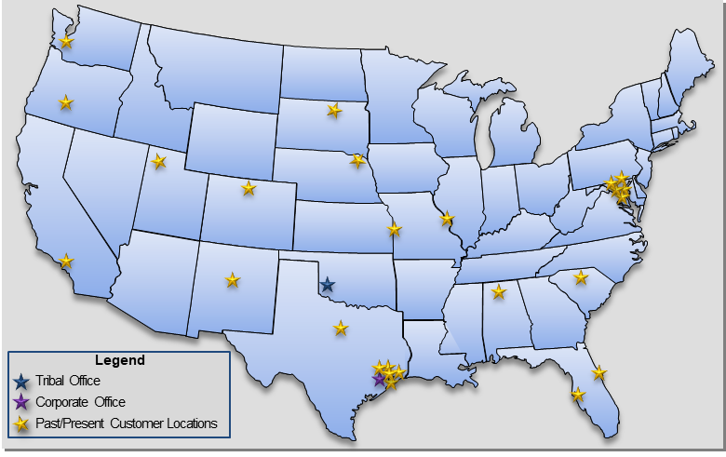
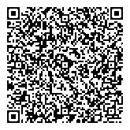
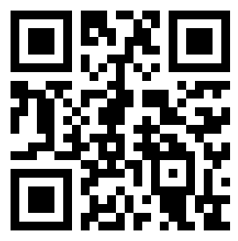
Anadarko Industries, LLC
Anadarko Industries (AI) is a Native American Tribal-Owned Small Disadvantaged Business (SDB)
providing value added services to the Federal Government for over 21 years.
CAGE Code: 3K4Q0
UEI #: LLRFLKCWAFC6
Core Capabilities
Information Technology Services
Help Desk/End User Support (Tiers 1, 2, 3)
Systems Management (Networks, Cloud, Servers)
Software Development and Maintenance
Field Studies / Benchmarking
Asset Management
SAM Revenue: $6.6M
SAM Employees: 49
Customers and Locations Supported
Logistics and Facility Operations
Warehousing Operations
Shipping and Receiving; including Flight Equipment
Inventory Management
Material Management; including Hazmat Items
Staging and Site Delivery
VIP Tours and Chauffer Services/Police Escorts
MILDEC Operations
IT Asset Management in Remedy
Work Order Management in MAXIMO
Facility Engineering Management
Federal Agencies: Air Force Office of Scientific Research (AFOSR) Department of Defense NASA (JSC, KSC, MSFC) Office of Naval Research USDA Forest Service USDA OCIO - Nationwide | Prime Contractors: The Boeing Company CACI, Inc. JMark Services KBRwyle ManTech MEI Technologies, Inc. PAE Applied Technologies STS Systems Integrations UTC Aerospace Systems
Engineering & Technical Services
Institutional Safety
Fire Protection, Engineering & Technical Support
OSHA VPP/Occupational Health
Safety Metrics and Analytics
Health and Human Performance
Biomedical and Scientific Research
Human Factor Analysis
Systems Engineering and Integration
Aerospace, Mechanical, Electrical, GN&C, ECLSS
Payloads Integration / Mission Operations
Facility Engineering
Test Safety Operations
Doing Business as a Small Business:
493110 | 519290 | 541380 | 541512 | 541513
541519 | 541611 | 541330 | 541690 | 541715
541930 | 541990 | 561110 | 561210
Business & Contract Operations
Awards , Recognitions & Certifications
Program Management
Contract Management
Financial Analysis
Procurement and Acquisition Services
Property and Asset Management
Human Resources Management
Administrative and Clerical Support
USDA Small Disadvantaged Business of the Year
NASA JSC Mentor of the Year
Houston Business Journal Recognized Top 11 Largest Houston Minority Employers
OSHA Voluntary Protection Program STAR Certification
Texas HUB Vendor
Seaport NxtGen Prime, NITAAC CIO-SP3 SB Prime
Corporate Office
1322 Space Park Drive, Suite A160
Houston, Texas 77058
(281) 286-9200
(281) 286-9204 fax
www.anadarko-industries.com
Kenn Hall, President/CEO
(281) 286-9202
khall@anadarko-industries.com

